Slide 1
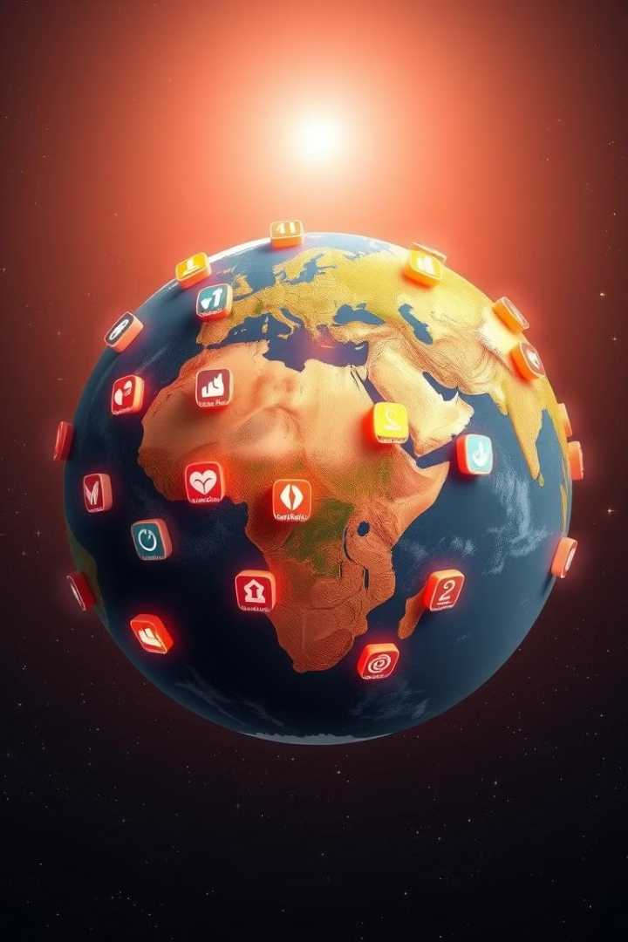
Demeters
Explore the world's biggest challenges and discover how you can make a difference.

Slide 2
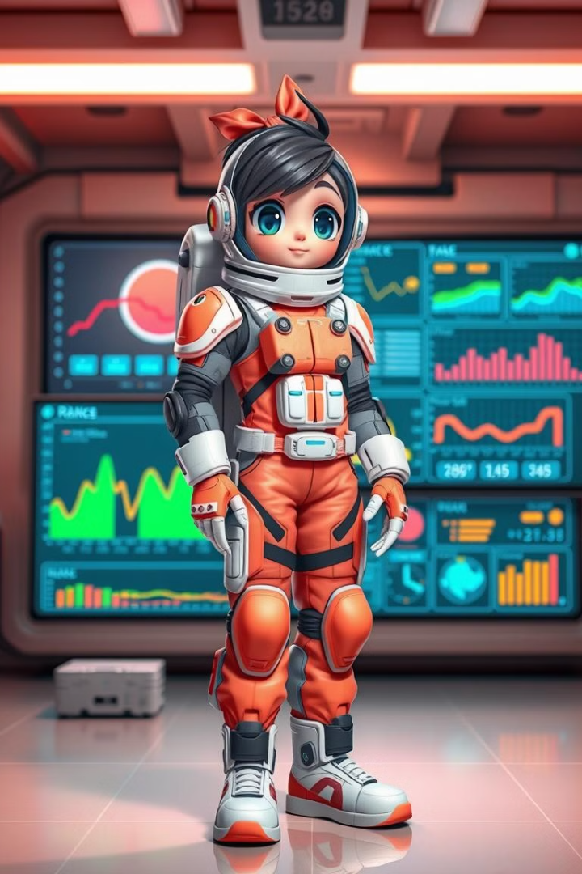
Engage & Learn
1
Interactive Gameplay
Play fun and engaging levels, each focused on a different SDG.
2
Decision Making
Use real-time data to make choices that impact the world.
3
Real World Impact
Learn how your decisions affect the planet and its people.
4
Gamified Learning
Master the challenges and become an SDG expert.

Slide 3
Real World Data
NASA Earthdata
Data Integration
Informed Decisions
Access real-time information from NASA satellites and research.
Use APIs to bring NASA data directly into the game.
Make decisions based on accurate and up-to-date data.

Slide 4
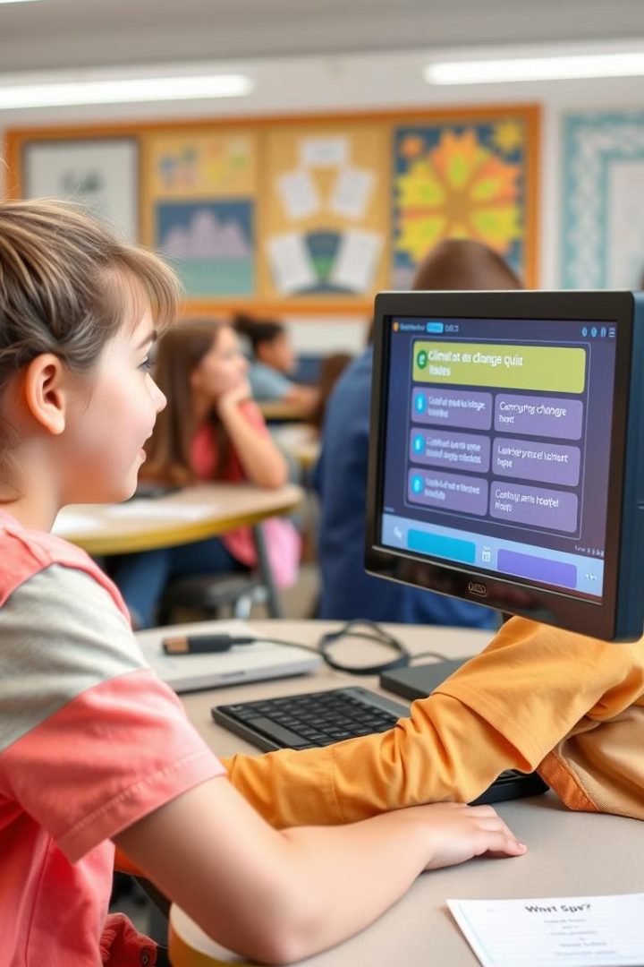
Reinforce Learning
1
Quizzes
Test your knowledge and see how much you've learned.
2
Simulations
Experience the consequences of your decisions in real-time.
3
Monitor Progress
Track your learning journey and watch your skills grow.

Slide 5
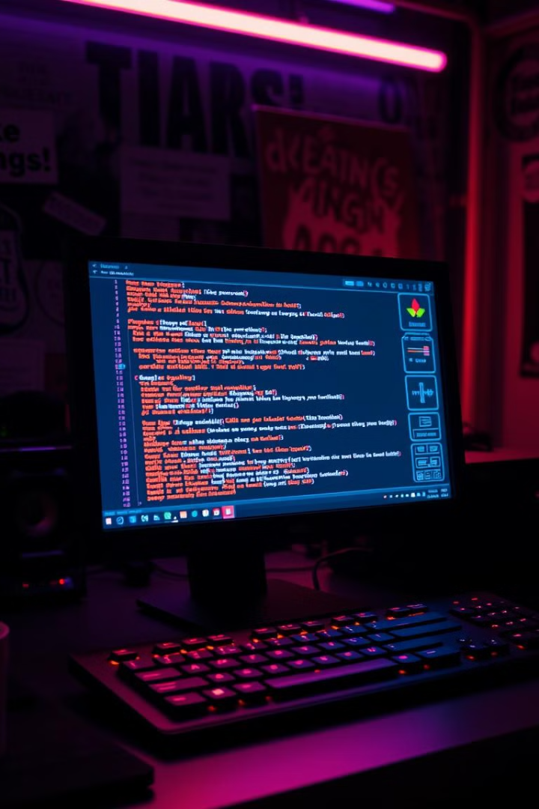
Technology Stack
Frontend
HTML5, CSS3, JavaScript (React.js).
Backend
Node.js, Python, MongoDB.
Design
Figma for UI design and user experience.

Slide 6





Development Process
Plan & Design
Create engaging levels based on SDG topics.
Integrate Data
Connect NASA data to make levels dynamic and interactive.
Test & Iterate
Get feedback from students and refine the game.
Deploy & Share
Make the game accessible to students and educators.

Slide 7





Reach Your Potential
Global Impact
STEM Education
Innovative Solutions
Empowerment
Learn how to address the world's most pressing issues.
Gain valuable skills in science, technology, engineering, and math.
Become a leader in the fight for a better world.
Develop creative solutions for a sustainable future.

Slide 8

Join the Movement
Become a part of the SDG Explorer project and help us make a difference.

